Slide 1


2024 5th GLOBAL CONFERENCE FOR ADVANCEMENT IN TECHNOLOGY (GCAT 2024)
Implementing a Multilingual Lexical Analyser for Java, C and C++
Paper ID: 457
Presenter: Nagasarapu Sarayu Krishna
Department of Computer Science and Engineering
Amrita School of Computing, Bengaluru
Amrita Vishwa Vidyapeetham, India

Slide 2
AGENDA
Introduction
Motivation, Challenges and Contribution
Research Gap
Workflow
Results and Analysis
Conclusion and Future Scope
References
457, Implementing a Multilingual Lexical Analyser for Java, C and C++, Sarayu, Bengaluru

Slide 3
INTRODUCTION
Lexical analysis is a core process in compiler and interpreter development, marking the first phase of compilation.
A lexer is essential for translating human-readable code into machine-executable instructions, which is vital for software development and IT industries.
It is used in programming language development, data analysis, and large text data processing.
Lexical analyzers detect lexical errors early, improving compilation efficiency by facilitating early debugging and optimizing performance.
457, Implementing a Multilingual Lexical Analyser for Java, C and C++, Sarayu, Bengaluru

Slide 4
INTRODUCTION
The lexical analyzer breaks source code into tokens, each representing a discrete, meaningful element of the code.
Tokens represent elements like keywords, identifiers, constants, operators, and symbols.
It is also responsible for cleaning the source program like stripping off blanks, tabs, newlines, and comments.
Single-language lexers are not ideal because they lead to redundancy in development, requiring separate lexers for each language, which increases complexity and maintenance efforts.
This research focuses on developing a Multilingual Lexical Analyzer for programming languages such as C, C++, and Java.
457, Implementing a Multilingual Lexical Analyser for Java, C and C++, Sarayu, Bengaluru

Slide 5
MOTIVATION, CHALLENGES & CONTRIBUTION
Motivation:
To leverage a unified lexical analysis for multiple programming languages, streamlining code compilation and improving efficiency across diverse programming ecosystems.
Challenges
Previous work faced challenges such as redundancy in maintaining separate lexers for each language, limited scalability, and inefficiencies in handling multi-language programming environments.
Contribution
This paper develops a multilingual lexical analyzer capable of processing and tokenizing code from C, C++, and Java within a unified system.
It introduces a modular approach for efficiently handling syntax and tokenization across multiple languages, improving compiler performance and scalability.
457, Implementing a Multilingual Lexical Analyser for Java, C and C++, Sarayu, Bengaluru

Slide 6
RESEARCH GAP
While previous research has developed separate lexical analyzers for individual programming languages, there remains a gap in creating a unified analyzer that can handle multiple languages within one system.
Language-specific lexers result in redundancy, increased maintenance efforts, and inefficiencies, especially in multi-language environments.
There is a need for a versatile analyzer that can accommodate various syntactic rules without sacrificing performance.
This research aims to bridge the gap by developing a streamlined and modular lexical analyzer that uses finite-state machines (FSMs) to dynamically handle tokenization and parsing across multiple languages.
By addressing this gap, the research contributes to reducing redundancy in lexer design, improving maintainability, and ensuring scalability for supporting evolving programming languages in modern software development environments.
457, Implementing a Multilingual Lexical Analyser for Java, C and C++, Sarayu, Bengaluru

Slide 7
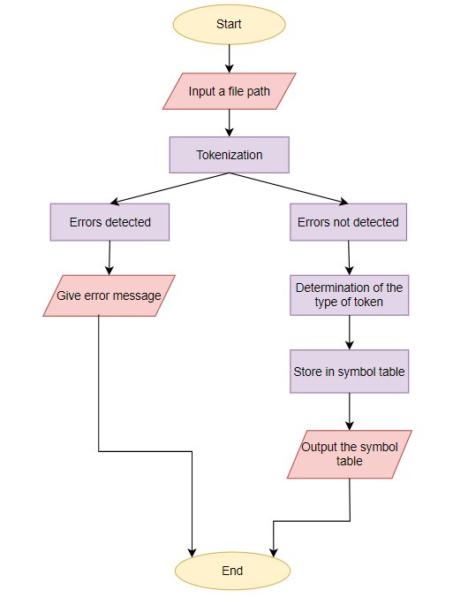
WORKFLOW
Figure 1: Workflow of the system
457, Implementing a Multilingual Lexical Analyser for Java, C and C++, Sarayu, Bengaluru

Slide 8
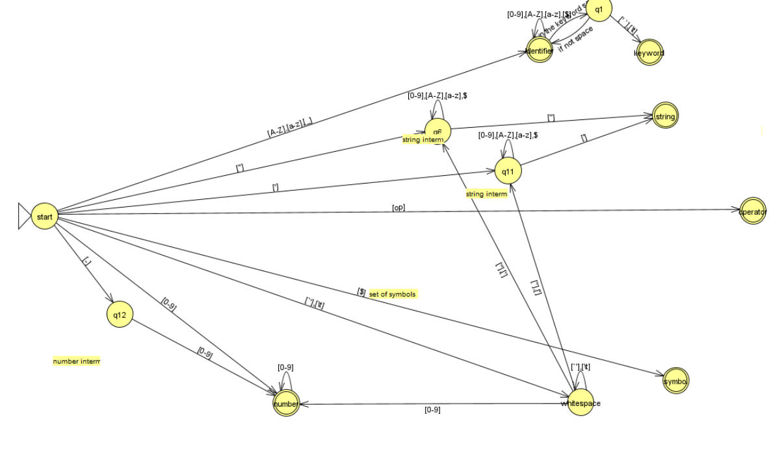
LeNet
LSTM
ResNet
Temporal Segment Networks (TSN)
Two-Stream CNN
VGGNet
Figure 2: NFA for the unified lexical analyzer for C, C++, and Java
457, Implementing a Multilingual Lexical Analyser for Java, C and C++, Sarayu, Bengaluru

Slide 9
TESTING
The system was tested using multiple code snippets from C, C++, and Java to evaluate the accuracy of tokenization across different languages.
The system was tested for:
Accurate recognition of token types such as keywords, identifiers, numbers, operators, and symbols.
Ability to detect syntax errors early in the tokenization phase, providing clear error messages to aid debugging.
Whether the system could transition between different token types dynamically.
Ability to handle language-specific constructs, verifying the lexer’s scalability for future languages.
457, Implementing a Multilingual Lexical Analyser for Java, C and C++, Sarayu, Bengaluru

Slide 10
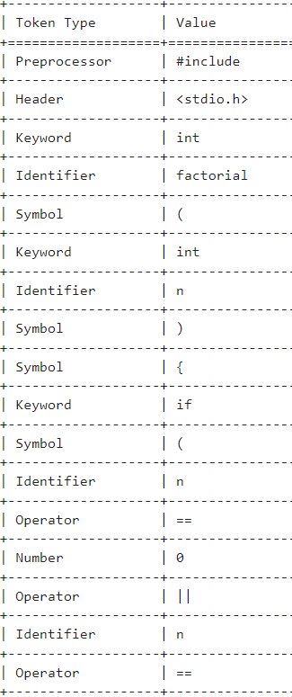
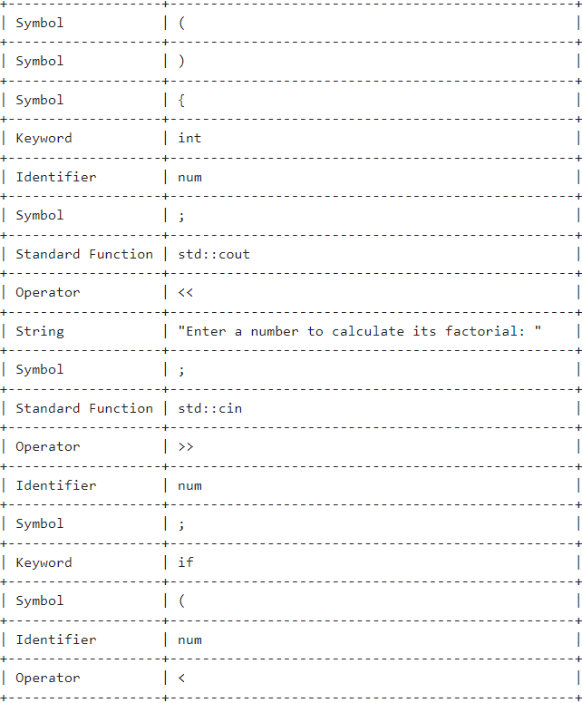
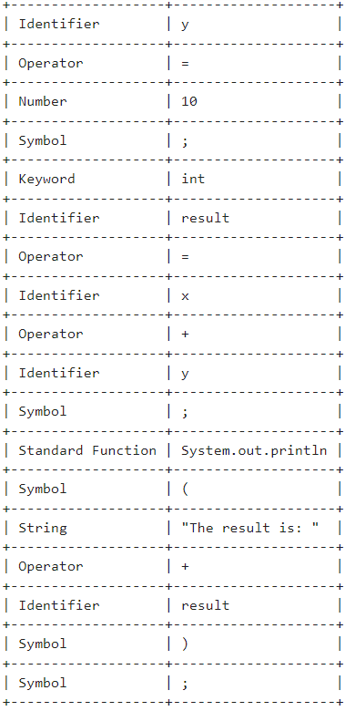
RESULTS
Figure 3: Test case 1 - Output for a factorial program in C
Figure 4: Test case 1 - Output for a factorial program
in C++
Figure 5: Test case 1 - Output for a factorial program in Java
457, Implementing a Multilingual Lexical Analyser for Java, C and C++, Sarayu, Bengaluru

Slide 11
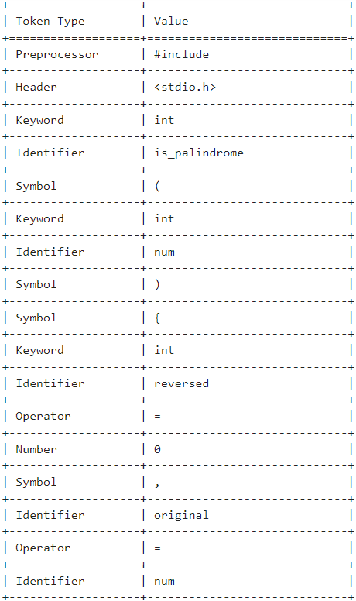
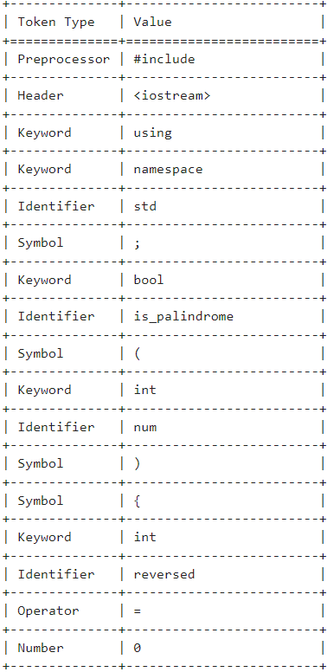
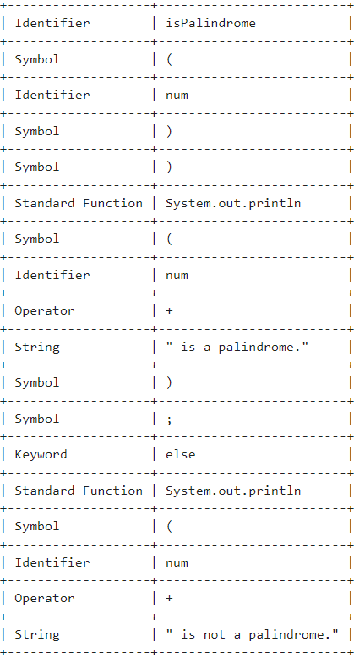
Figure 6: Test case 2 - Output for a palindrome program in C
Figure 7: Test case 2 - Output for a palindrome program
in C++
Figure 8: Test case 2 - Output for a palindrome program
in Java
457, Implementing a Multilingual Lexical Analyser for Java, C and C++, Sarayu, Bengaluru

Slide 12
ANALYSIS
The lexer consistently produced accurate token tables across C, C++, and Java code snippets, correctly identifying keywords, identifiers, operators, and other elements.
The error detection mechanism was highly effective, identifying lexical errors early in the compilation process.
The modular approach proved successful, ensuring that the system can be extended to support additional programming languages in the future with minimal modifications.
The use of FSMs enabled the system to dynamically transition between states, handling the different syntactic rules of each language smoothly.
The unified analyzer improves both redundancy and maintainability in multi-language environments, offering a scalable solution for modern software development.
457, Implementing a Multilingual Lexical Analyser for Java, C and C++, Sarayu, Bengaluru

Slide 13
CONCLUSION AND FUTURE SCOPE
CONCLUSION:
The unified lexical analyzer successfully tokenizes code from C, C++, and Java, reducing redundancy and improving efficiency in multi-language environments.
The system demonstrated reliable error detection and scalability, making it a robust tool for modern software development.
FUTURE SCOPE:
Support for Additional Languages
Machine Learning Integration
Performance Optimization
457, Implementing a Multilingual Lexical Analyser for Java, C and C++, Sarayu, Bengaluru

Slide 14
REFERENCES
[1] Farhanaaz, S., 2016. V, An Exploration on Lexical Analysis. In International Conference on Electrical, Electronics, and Optimization Techniques (ICEEOT) (Vol. 16487238).
[2] Ingale, V., Vayadande, K., Verma, V., Yeole, A., Zawar, S. and Jamadar, Z., Lexical analyzer using DFA. International Journal of Advance Research, Ideas and Innovations in Technology, www. IJARIIT. com.
[3] Ali Nayef, Z. (2019) “A Survey about various Generations of Lexical Analyzer”, Journal of Advanced Computer Science & Technology, 8(2), pp. 50–57.
[4] Alfred, V.A., Monica, S.L. and Jeffrey, D.U., 2007. Compilers principles, techniques & tools. pearson Education.
[5] Su, Y., Yan, S.Y. (2011). Lexical Analysis. In: Principles of Compilers. Springer, Berlin, Heidelberg.
[6] Di Angelo, M. and Salzer, G., 2020, August. Tokens, types, and standards: identification and utilization in Ethereum. In 2020 IEEE International Conference on Decentralized Applications and Infrastructures (DAPPS) (pp. 1-10). IEEE.
[7] Mickunas, M.D. and Schell, R.M., 1978, December. Parallel compilation in a multiprocessor environment. In Proceedings of the 1978 annual conference (pp. 241-246).
[8] Srikanth, G.U., 2010, June. Parallel lexical analyzer on the cell processor. In 2010 Fourth International Conference on Secure Software Integration and Reliability Improvement Companion (pp. 28-29). IEEE.
457, Implementing a Multilingual Lexical Analyser for Java, C and C++, Sarayu, Bengaluru

Slide 15
REFERENCES
[9] Khonji, M., Iraqi, Y. and Jones, A., 2012. Enhancing phishing e-mail classifiers: A lexical url analysis approach. International Journal for Information Security Research (IJISR), 2(1/2), p.40.
[10] Abutaha, M., Ababneh, M., Mahmoud, K. and Baddar, S.A.H., 2021, May. URL phishing detection using machine learning techniques based on URLs lexical analysis. In 2021 12th International Conference on Information and Communication Systems (ICICS) (pp. 147-152). IEEE.
[11] Pranave, K.C., Challa, V.K.R. and Panda, N., 2024. System Search Service Implementation Based on a Custom Lexical Search. Procedia Computer Science, 235, pp.1548-1557.
[12] Verma, M., 2017. Lexical analysis of religious texts using text mining and machine learning tools. International Journal of Computer Applications, 168(8), pp.39-45.
[13] Likhith, A.N., Gurunadh, K., Chinthapalli, V. and Belwal, M., 2023, November. Compiler For Mathematical Operations Using English Like Sentences. In 2023 7th International Conference on Computation System and Information Technology for Sustainable Solutions (CSITSS) (pp. 1-6). IEEE.
[14] https://lambda.uta.edu/cse5317/long/long.html
[15] Eastman, C.M., 1983. A lexical analysis of keywords in high level programming languages. International journal of man-machine studies, 19(6), pp.595-607.
457, Implementing a Multilingual Lexical Analyser for Java, C and C++, Sarayu, Bengaluru

Slide 16
REFERENCES
[16] Ptolemaeus, C. ed., 2014. System design, modeling, and simulation: using Ptolemy II (Vol. 1). Berkeley: Ptolemy. org.
[17] Nambiar, A.S., Likhita, K., Sri Pujya, K.V.S. and Supriya, M., 2022. Design of Super Mario Game Using Finite State Machines. In Computer Networks and Inventive Communication Technologies: Proceedings of Fifth ICCNCT 2022 (pp. 739-752). Singapore: Springer Nature Singapore.
[18] Jaswanth, M., Narayana, N.K., Rahul, S. and Supriya, M., 2022, April. Autonomous car controller using behaviour planning based on finite state machine. In 2022 6th International Conference on Trends in Electronics and Informatics (ICOEI) (pp. 296-302). IEEE.
[19] Srimani, P.K. and Nasir, S.F.B. (2007) ‘Context-Free Grammars and Context-Free Languages’, in A Textbook on Automata Theory. Foundation Books, pp. 304–376.
[20] Nagarajan, H., Vancha, P. and Supriya, M., 2022, July. Recognising the English language using context free grammar with pyformlang. In 2022 IEEE International Conference on Electronics, Computing and Communication Technologies (CONECCT) (pp. 1-6). IEEE.
[21] Asmitha, M. and Panda, N., 2024, May. Exploring Different Methods of Scanners and Parsers. In 2024 International Conference on Advances in Modern Age Technologies for Health and Engineering Science (AMATHE) (pp.1-7).IEEE.
457, Implementing a Multilingual Lexical Analyser for Java, C and C++, Sarayu, Bengaluru

Slide 17
THANK YOU
457, Implementing a Multilingual Lexical Analyser for Java, C and C++, Sarayu, Bengaluru

